Slide 1
storage management system
Zehua yu Student no. g00307279

Slide 2

Client introduction

Slide 3
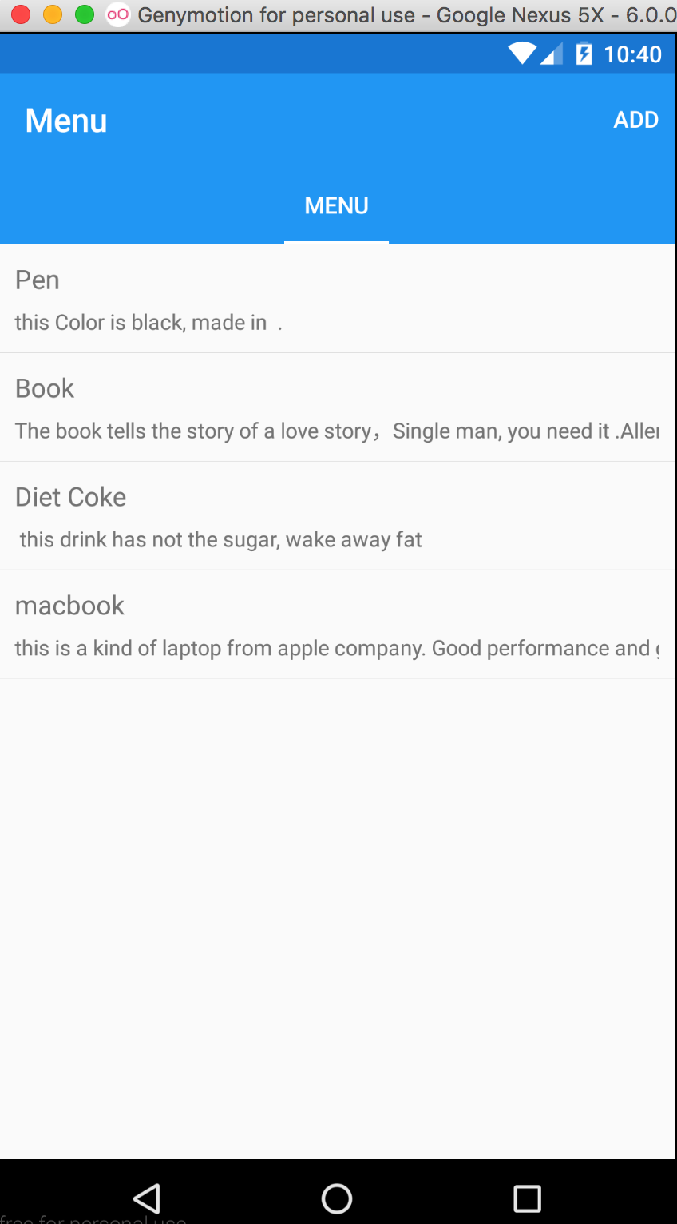
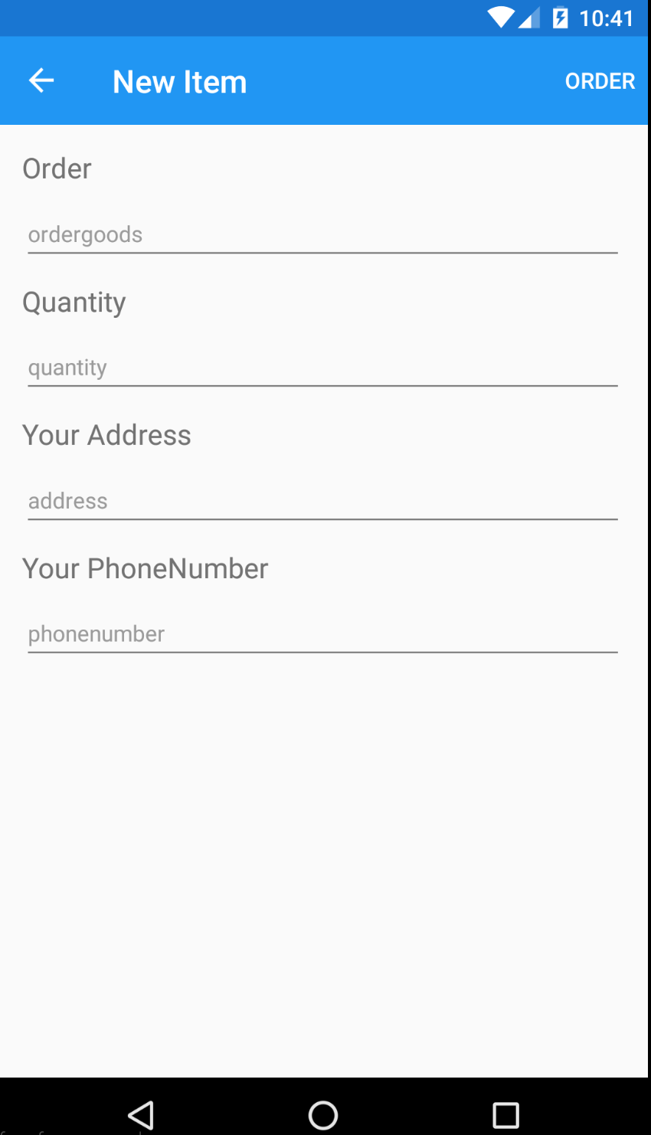
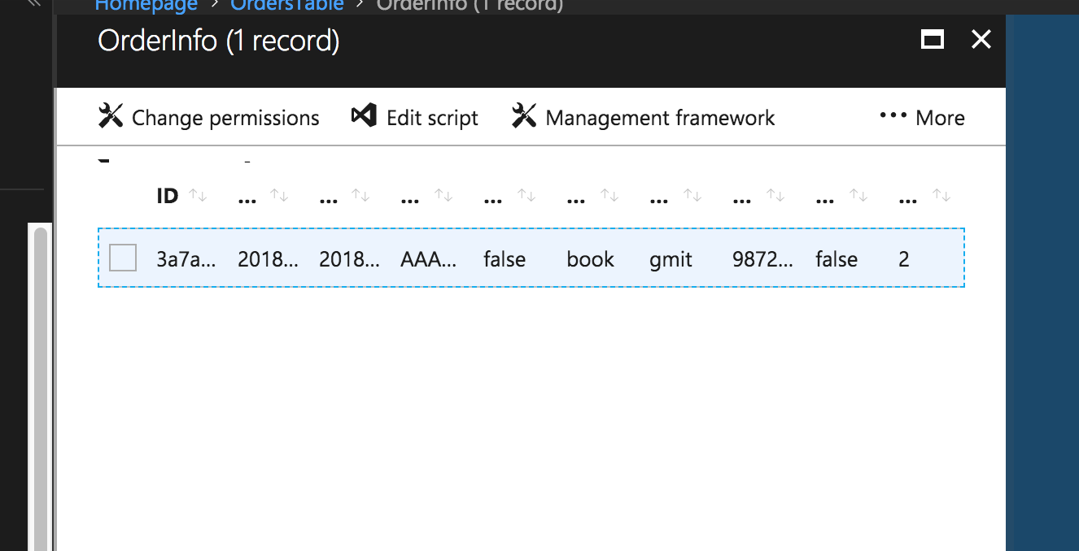
Presentation
The client is based on android or IOS system, the user can look at the menu UI and post order to Cloud service.

Slide 4
The explanation of code
Presentation
public partial class NewItemPage : ContentPage { //connecting the Azure server public static MobileServiceClient MobileService = // connect the azure service but coder need established the Azure Web new MobileServiceClient( //service first. The URL is azure service address "https://ordertable.azurewebsites.net" );
CurrentPlatform.Init(); OrderInfo item = new OrderInfo { OrderGoods = text1, address = text2, // insert the data to the databases. phonenumber = text3, quantity = quan, status = text4 } ; await MobileService.GetTable<OrderInfo>().InsertAsync(item); // init the cloud service and post the data. await Navigation.PushAsync(new MainPage());

Slide 5

computer application

Slide 6
management application
Presentation
This application has the sample managing functionality.
Receive the order from client, and update the databases.
there is local databases to manage basic products information.
Login interface

Slide 7
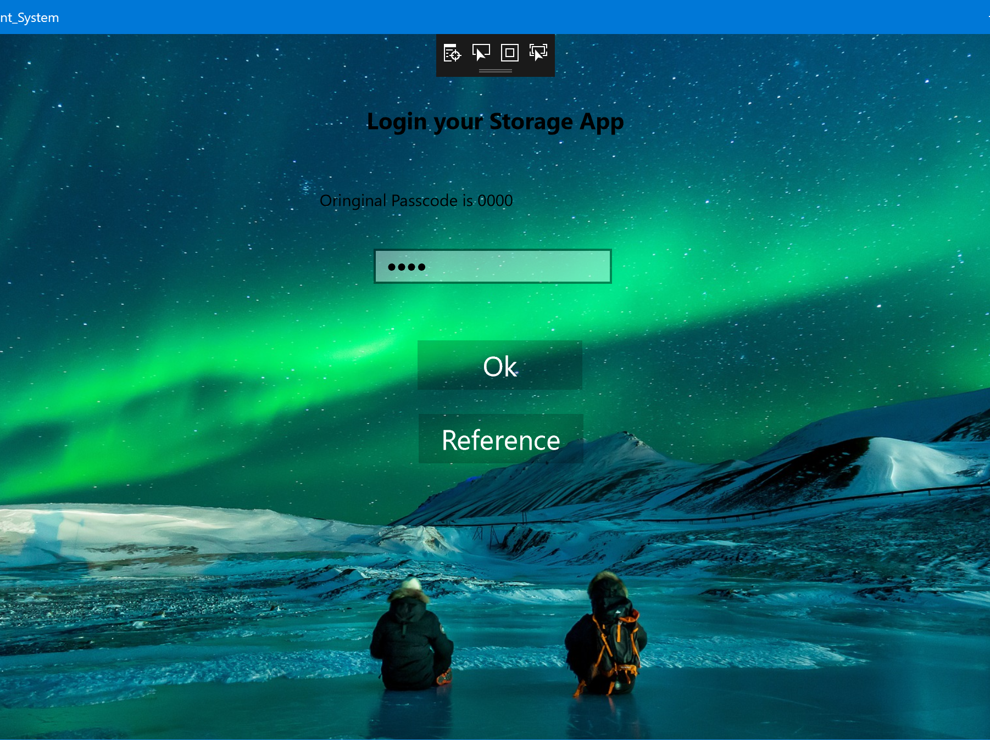
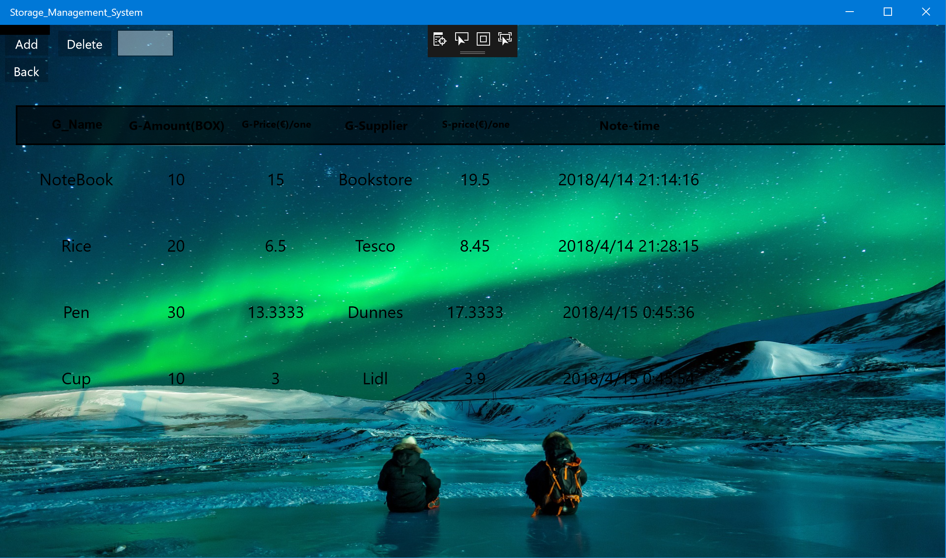
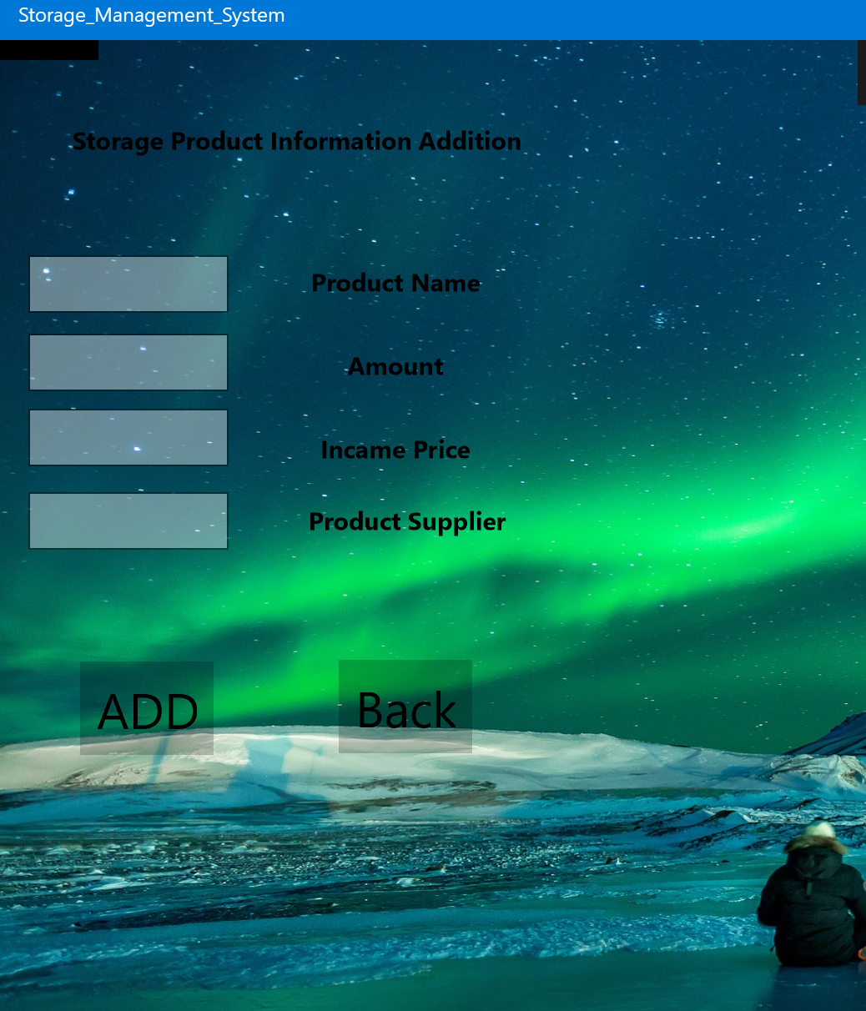
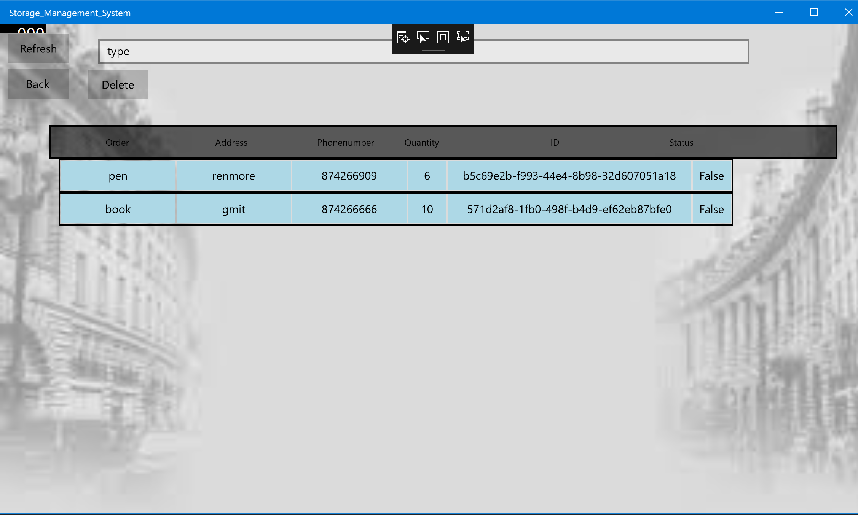
Local storage page, all of data is stored in SQLit
login page , type the passcode.
This page let use input the data to databases.
The order management page , the user can manage all of order here

Slide 8

presentation
Azure service
mobile phone client
Computer application
This flow chart shows the function of the order of general principles， after computer receives the data from Azure. By the binding functionality to show all of the data on the page.

Slide 9

presentation
Adding the data by right page
this is products management page,Users only need to input the total number of goods and the total price, the system will calculate the unit price and profit for 30% of the price

Slide 10
The explanation of code
presentation
private MobileServiceCollection<OrderInfo, OrderInfo> items;
IMobileServiceTable<OrderInfo> toTable = App.client.GetTable<OrderInfo>();
async void gettable()
{
MobileServiceInvalidOperationException exep = null;
try
{
items = await toTable.ToCollectionAsync(); // get the data from the Azure databases, Depend on this way i can add the update remove
// and so on functionality.
}
catch (MobileServiceInvalidOperationException ex)
{
exep = ex;
}
if (exep == null) MylistView.DataContext = items;
}
async void update() // update functionality
{
MobileServiceInvalidOperationException exep = null;
string info = intype.Text;

Slide 11
Text
<Border Background="LightBlue" Grid.ColumnSpan="3" Height="40" BorderThickness="1" VerticalAlignment="Top">
<TextBlock Grid.Column="1" Text="{Binding Path=address}" HorizontalAlignment="Center" VerticalAlignment="Center" TextAlignment="Center" Width="150"></TextBlock>
</Border>
<Border Background="LightBlue" Grid.ColumnSpan="3" Height="40" BorderThickness="1" VerticalAlignment="Top">
<TextBlock Grid.Column="1" Text="{Binding Path=phonenumber}" HorizontalAlignment="Center" VerticalAlignment="Center" TextAlignment="Center" Width="150"></TextBlock>
</Border>
<Border Background="LightBlue" Grid.ColumnSpan="3" Height="40" BorderThickness="1" VerticalAlignment="Top">
<TextBlock Grid.Column="1" Text="{Binding Path=quantity}" HorizontalAlignment="Center" VerticalAlignment="Center" TextAlignment="Center" Width="50"></TextBlock>
</Border>
<Border Background="LightBlue" Grid.ColumnSpan="3" Height="40" BorderThickness="1" VerticalAlignment="Top">
<TextBlock Grid.Column="2" Text="{Binding Path=Id}" HorizontalAlignment="Center" VerticalAlignment="Center" TextAlignment="Center" Width="320"></TextBlock>
</Border>
<Border Background="LightBlue" Grid.ColumnSpan="3" Height="40" BorderThickness="1" VerticalAlignment="Top">
<TextBlock Grid.Column="1" Text="{Binding Path=status}" HorizontalAlignment="Center" VerticalAlignment="Center" TextAlignment="Center" Width="50"></TextBlock>
</Border>
this data binding, the UI directly show data from databases.

Slide 12
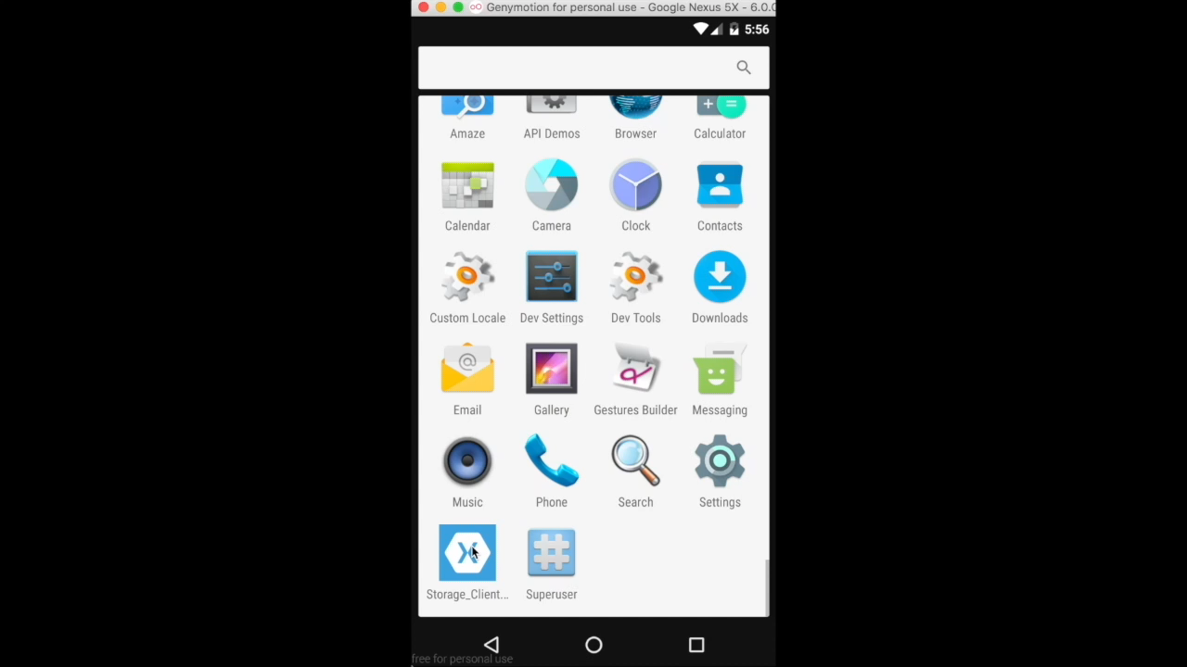
Video
Text

